Slide 1
Python program to generate a random strong password
Ingrid Mongori Yondo
13/12/2021

Slide 2
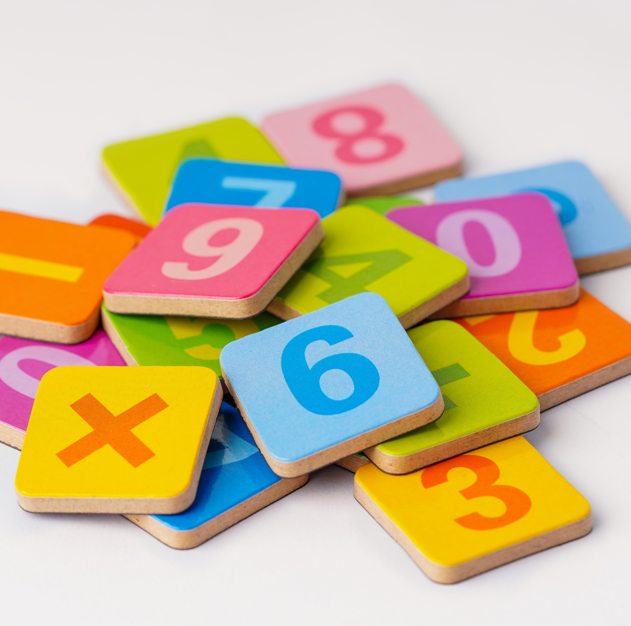
What is a password?
“A password is a basic security mechanism that consists of a secret pass phrase created using alphabetic, numeric, alphanumeric and symbolic characters, or a combination. A password is used to restrict access to a system, application or service to only those users who have memorized or stored and/or are authorized to use it.
A password may also be called an access code, PIN or secret code.”
Techopedia

Slide 3
Challenges
Minimum length 6 characters.
Maximum length 16 characters.
At least 1 letter between [a-z] and 1 letter between [A-Z].
At least 1 number between [0-9].
At least 1 character from [$#@].

Slide 4
Process
Length
4 Lists
Sampling the join list of all characters
Making a list from 6 to 16 characters
Mixing the characters
Joining the characters
Password

Slide 5
LET’S CODE!

Slide 6

import random
import string
length = random.randrange(2,12)
lower = string.ascii_lowercase
upper = string.ascii_uppercase
number = string.digits
special_char = "@#$"
all = lower + upper + number + special_char
sample = "".join(random.sample(all,length))
char_list = [random.choice(special_char),
random.choice(lower),
random.choice(upper),
random.choice(number),
sample]
random.shuffle(char_list)
password = ''.join(char_list)
print(password)
Python

Slide 7
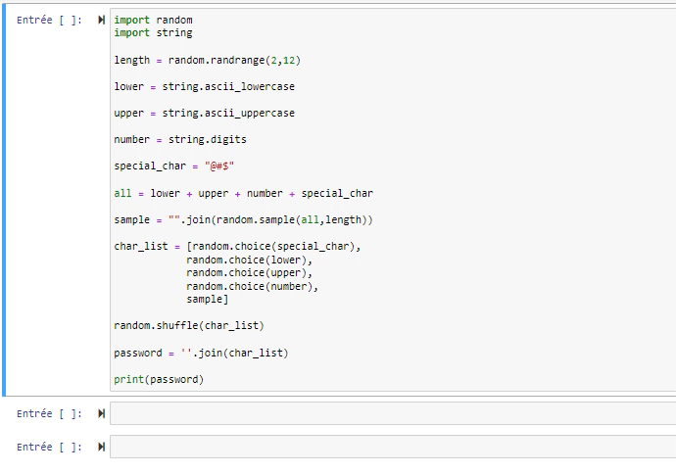

Demo
Passwords: 7@yMPB5cRU@U ; 7taG0s5#Le9 ; Ah@9iV06Q0XI# ; @y8a8WwnEPb$dP, …

Slide 8


